Slide 1

Topic: Threads and Concurrency in Operating Systems Department: Software Engineering University: CWNU

Slide 2

What is a Thread?
A thread is the smallest part of a process that can run independently.
Every process has at least one thread (called the main thread).
Threads share the memory and resources of their process.
🧠 Example: In a browser, one thread loads the page while another plays a video.

Slide 3


What is Concurrency?
Concurrency means two or more tasks are happening at the same time (not necessarily simultaneously).
The system switches between tasks very fast, making it look like they run together.
Concurrency improves efficiency and performance.
🧠 Think of it like a chef cooking many dishes by switching between them quickly

Slide 4

Difference Between Process and Thread
Feature | Process | Thread
Memory | Has its own | Shares memory
Speed | Slower to create | Faster to create
Communication | Hard (IPC needed) | Easy (shared memory)

Slide 5

Why Threads Are Useful
Faster and lighter than processes
Saves system resources
Makes apps more responsive
Useful in:
>Games
>Servers
>Mobile apps
副标题 A

Slide 6
Single-thread vs Multi-thread
Single-threaded
Executes one task at a time
Slower and less responsive
Simple to develop and debug
Uses only one CPU core
Not ideal for multitasking
Example: A basic music player that plays music first, then updates the screen later
副标题 A
Multi-threaded
Executes multiple tasks concurrently
Faster and more responsive
More complex to develop (requires synchronization)
Utilizes multiple CPU cores
Ideal for multitasking
Example: A modern music player that plays music, shows animation, and responds to user input at the same time

Slide 7
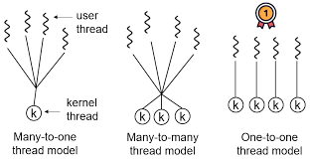
Types of Threads
User-level Threads (ULT):
Managed by the program, not the OS
Very fast
Kernel-level Threads (KLT):
Managed by the Operating System
Slower but more powerful
Hybrid Threads:
Combination of ULT and KLT
Used in modern OS

Slide 8
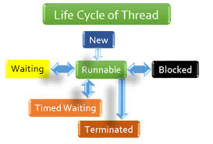
Thread Life Cycle
New: Thread is created
Ready: Waiting for CPU
Running: Using the CPU
Blocked/Waiting: Waiting for something (like I/O)
Terminated: Finished execution
🧠 Add a diagram of this flow here for clarity

Slide 9
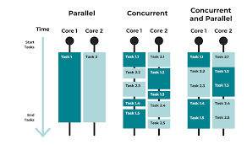
Parallelism means two or more tasks actually run at the same time (on different CPU cores).
Requires a multicore CPU.
Concurrency ≠ Parallelism (Concurrency is switching; Parallelism is truly doing things at once.)

Slide 10
How OS Manages Threads >OS uses a scheduler to decide which thread runs next. >Context switching happens when CPU changes from one thread to another. >OS gives each thread some time to run.
Critical Section
A critical section is a part of the program where shared data is used.
Only one thread should enter this part at a time.
Helps avoid race conditions.
🧠 Think of it like one person using the restroom at a time.

Slide 11
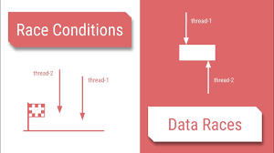
Race Condition
Happens when two threads use the same data at the same time.
If not controlled, it causes incorrect results.
Problem example:
Two people withdrawing money from one account at the same time

Slide 12
Deadlock
A deadlock occurs when two or more threads (or processes) are stuck waiting for each other to release resources, and none of them can continue. It creates a situation where all the involved threads are blocked forever, and the program cannot make any further progress. Deadlocks usually happen when multiple threads hold some resources and try to acquire additional ones held by others — creating a circular waiting loop.
🧠 Real-Life Example:
Imagine two cars coming from opposite directions on a narrow one-way street. Each car needs the other to move back to make room, but neither can move unless the other does so first. Since both are waiting, no one moves, and the road is completely blocked — this is exactly how a deadlock works in computing.
💡 Summary:
Deadlock = Mutual waiting forever
Caused by poor resource management and locking
Needs proper handling (e.g., timeout, deadlock detection)

Slide 13

Starvation and Livelock
Starvation: A thread waits too long and never gets to run.
Livelock: Threads keep running but don’t make progress (just reacting to each other).

Slide 14
Thread Libraries
Help us create and manage threads in programs.
Examples:
Pthreads (C/C++)
Java Threads
Windows Threads
These provide:
Thread creation
Joining threads
Synchronization

Slide 15
Conclusion
Threads are small and efficient parts of processes.
Concurrency makes systems fast and responsive.
Use synchronization to avoid errors.
Essential for modern apps and operating systems.
📚 Simple Books to Refer:
Operating System Concepts – Silberschatz
Modern Operating Systems – Tanenbaum
OS Internals and Design Principles – William Stallings

